Slide 1


Sewage in Our Waters
LSE Environment Week
26/09/2024
Introduction
Dr. Swati Dhingra

Slide 2
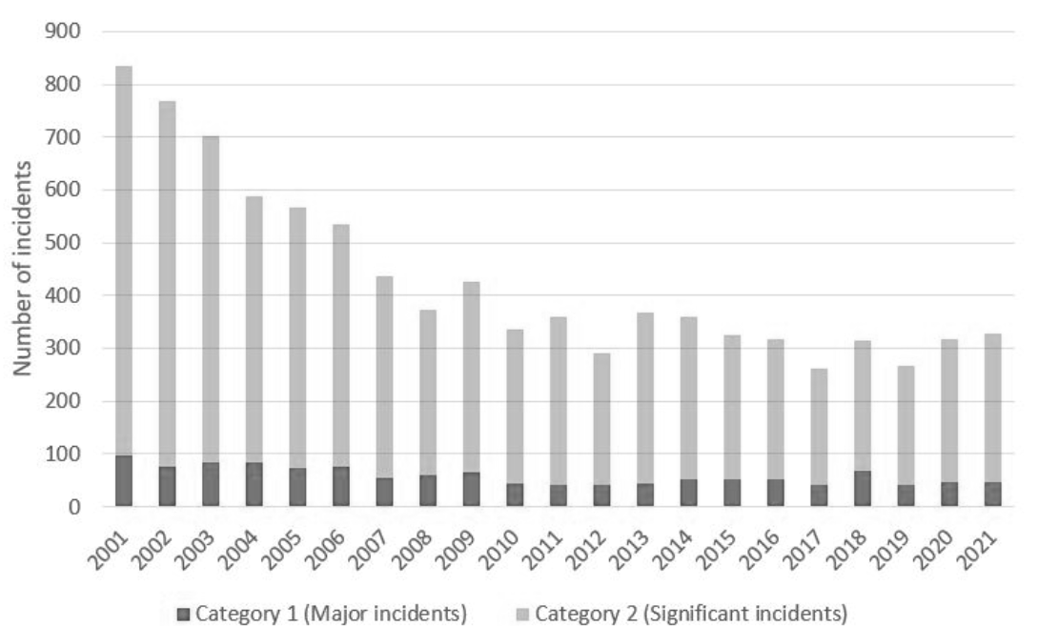
Serious Water Pollution Incidents in England
Source: DEFRA

Slide 3
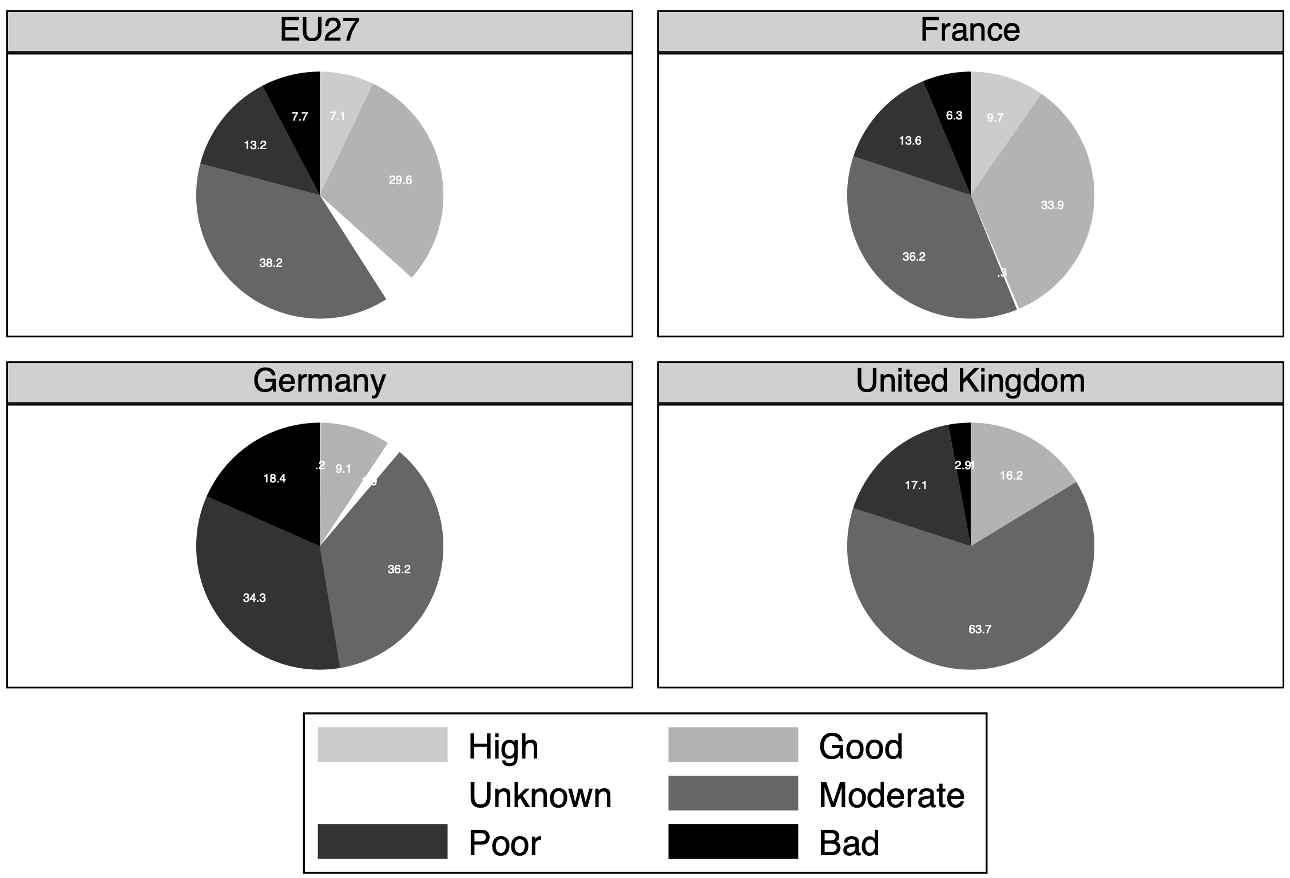
Surface Water Ecological Status
Source: DEFRA and WISE for 2016-2021

Slide 4
Commitment Targets of Water Companies
Source: House of Commons 2024

Slide 5
Industry capital expenditures over time
Source: Ofwat

Slide 6
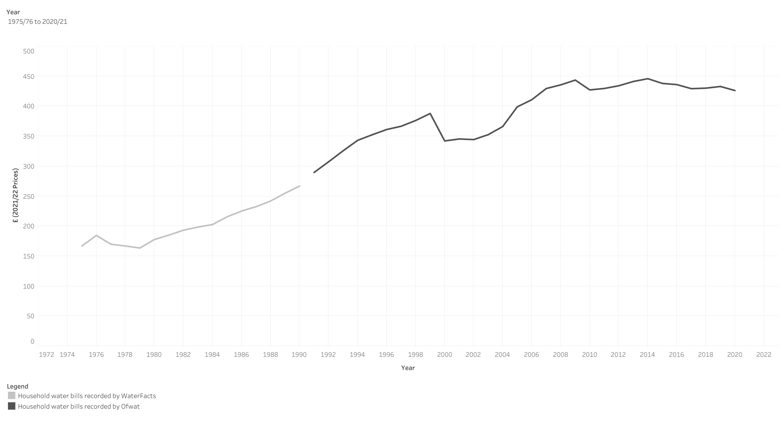
Water and sewerage bills over time

Slide 7
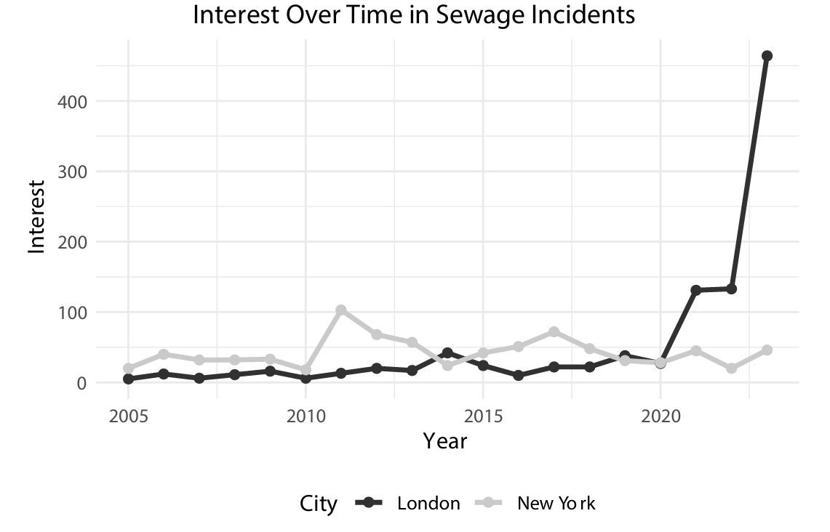
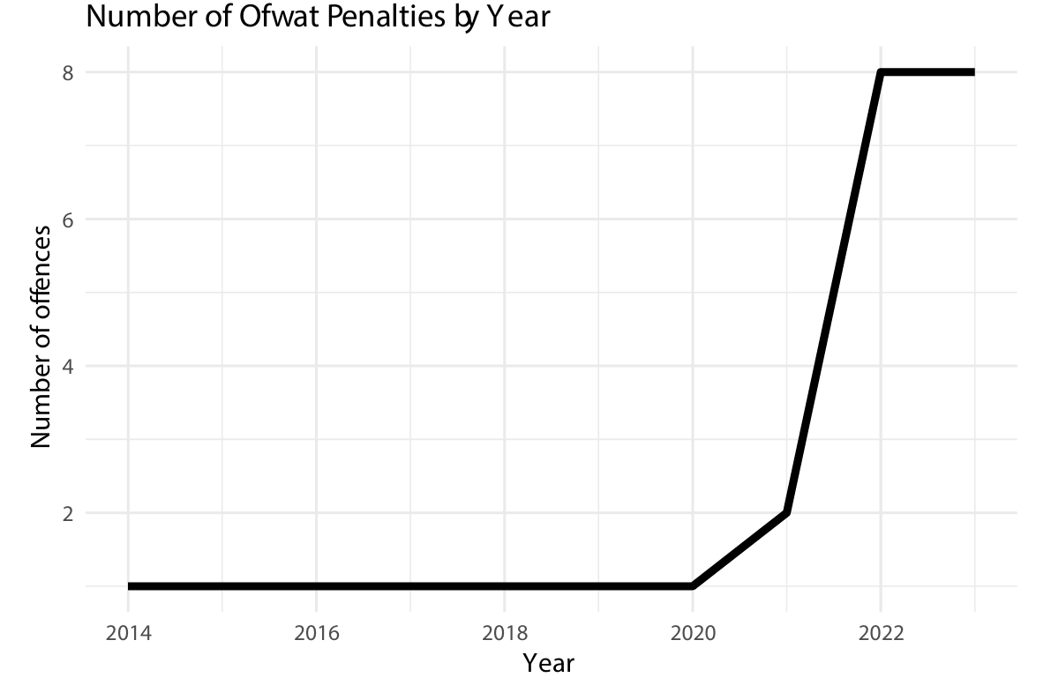
Public sentiment and action
Source: Lexis Nexis analysis and Ofwat

